Slide 1
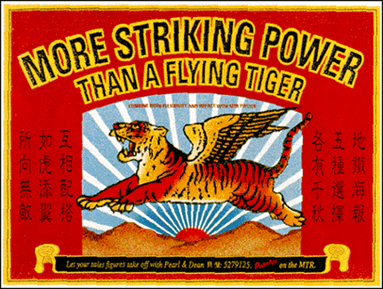
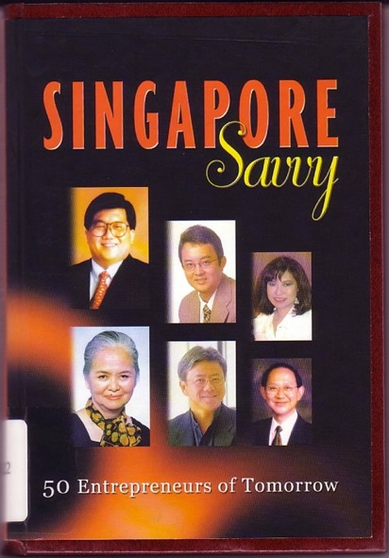
Lecture 8
Entrepreneurship in Singapore: Case studies
GES1009/ Semester 2
Dr. Brunero

Slide 2
Entrepreneurship as a concept changes and evolves over time
Sources? Materials?
Newspaper features
Television documentaries
Biographies
Chambers of Commerce
Government agencies & initiatives?

Slide 3
Entrepreneurship…
A businessman/woman who owns an enterprise and who is prepared to take risks in order to increase profits
The attitudes, activities and behaviours that contribute to the creation, development and sustaining of an enterprise.
Managers of organizations as well as innovators?
The Cultural Entrepreneur…

Slide 4
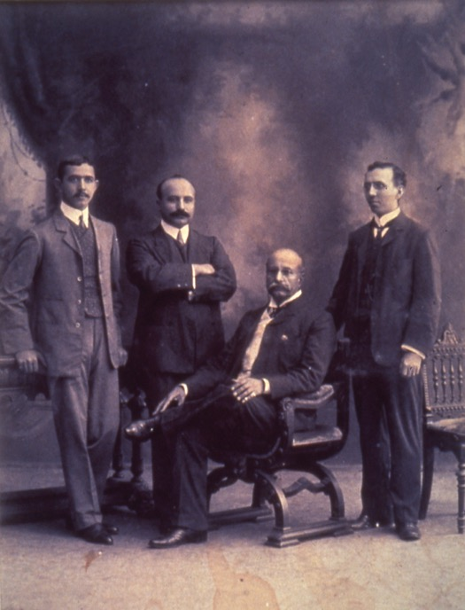
Early entrepreneurship…
Co-ethnic enterprises
Liquid capital
Family networks
Social status through business success?
The Sarkies Brothers (from left), Aviet, Arshak, Martin (seated) and Tigran were the founders of Raffles Hotel. This is the only known picture of the four Armenian brothers together and was probably taken around 1905. PHOTO: RAFFLES HOTEL

Slide 5
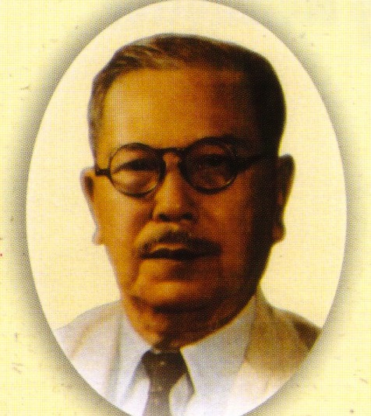
Tan Kah Kee (1874-1961)
Business and Community leadership
Vertical integration of businesses
Use of family ties, ethnic-based networks but also meritocracy.
Pineapple canneries, shipping, rubber.
Philanthropy

Slide 6
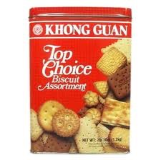
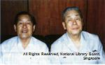
Some inspiration…
Chew Choo Keng, the name behind Khong Guan biscuits.
“Business is like riding on a tiger, if one does not go forward, one is liable to be eaten by the tiger. One has to go forward.” Chew Choo Keng, in Stepping Out: The Making of Chinese Entrepreneurs.

Slide 7
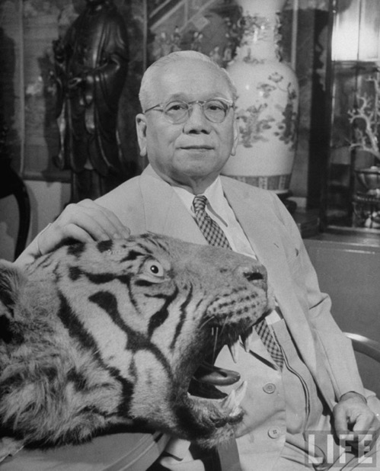
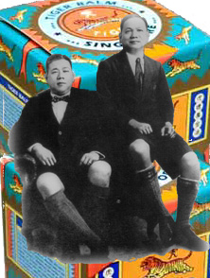
AW Boon Haw and Aw Boon Par: The Tiger Balm kings…
A family business, capitalizing on networks throughout Southeast Asia
Innovation and determination.

Slide 8
1965-1980s
The idea of GLC as the key to state-led entrepreneurship (‘two-legged policy’).
The Economic Development Board encouraged the growth of the electronics and petrochemical industries in SG.
The SME Masterplan of 1989 was an important turning point in recognizing the need to support entrepreneurs in SMEs.

Slide 9
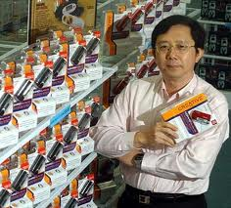
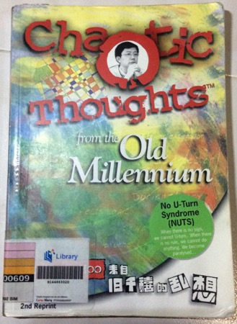
Sim Wong Hoo
Creative Industries
Created the sound blaster card.
Seen as a new type of entrepreneur: the technopreneur.
Criticism that Singapore didn’t encourage people to take risks in business.

Slide 10
Current Trends in Entrepreneurship
Increasing number of female entrepreneurs
Reinvention of ‘traditional businesses’
Greater diversity – education, experience, resources, international travel – young entrepreneurs.
Technopreneurs and a start up culture…

Slide 11
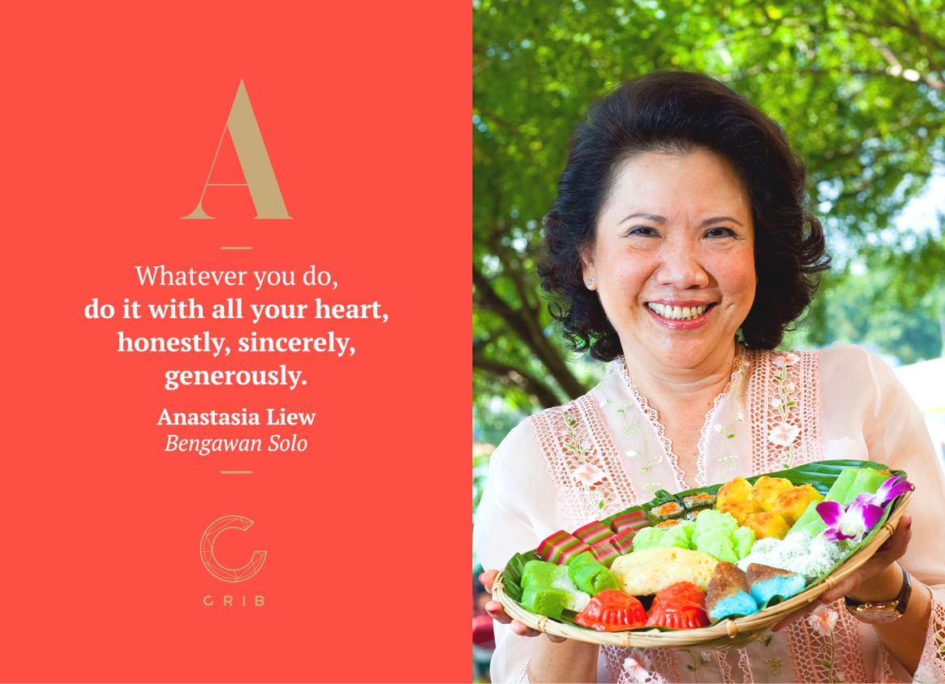
1. Female Entrepreneurs
http://www.crib.com.sg/women4women/inspire/

Slide 12
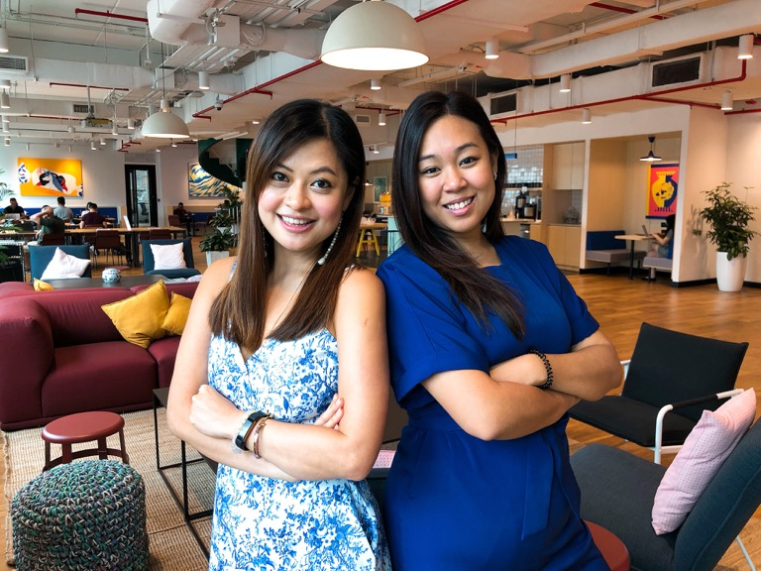
Delegate co-founded by Jacqueline Ye and Melissa Lou
Source: Business Insider, March 2019

Slide 13
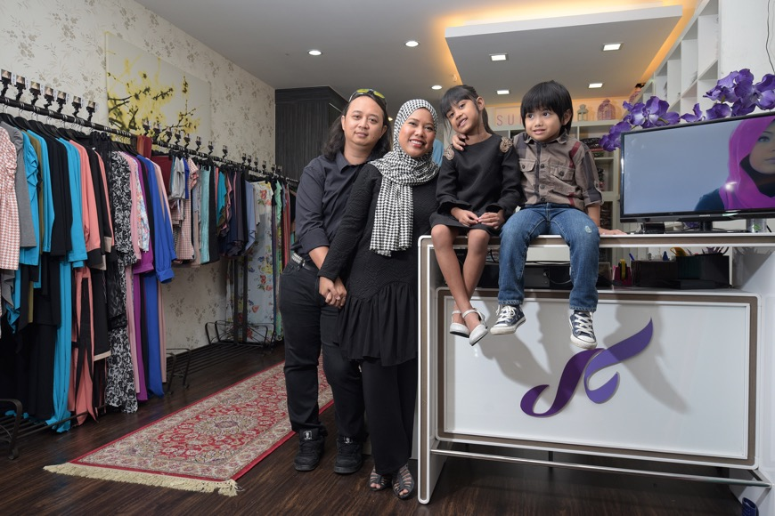
Sufyaa
Founded by Azrina Tahar.
Source: The Straits Times, 29 Nov 2015.

Slide 14

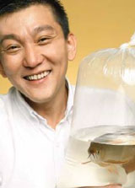
2. ‘Reinvention’
Origins:
The Yap brothers were pig farmers.
In the 1980s their sons converted the farmland into fish ponds to breed fish for the local market.
---------------
Kenny Yap: Executive Chairman and Managing Director of Qian Hu. (Family members form a core of business management).
Wholesale and retail.
Diversification of interests.
Overseas joint-ventures.

Slide 15
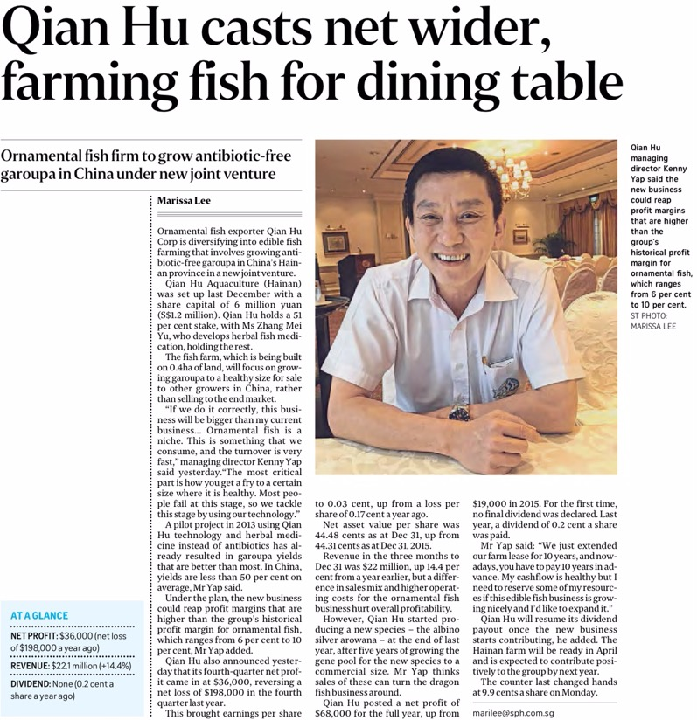
The Straits Times 13/1/2017

Slide 16
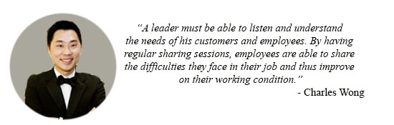
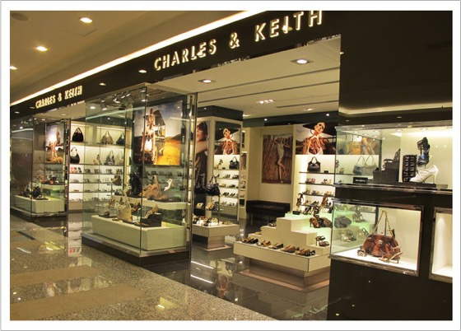
Charles and Keith
Origins? A family shoe store in Ang Moh Kio.
Charles and Keith Wong.
1996-- 500 square feet store in Amara Shopping Centre Singapore
Today Charles & Keith has over 500 stores world wide.

Slide 17
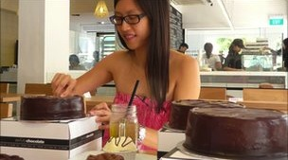
3. Diversity
Many young entrepreneurs and new companies
A good environment for start ups but potentially a tough market (F&B for example).
Government support: pros and cons?
Young entrepreneurs encouraged to look globally…

Slide 18
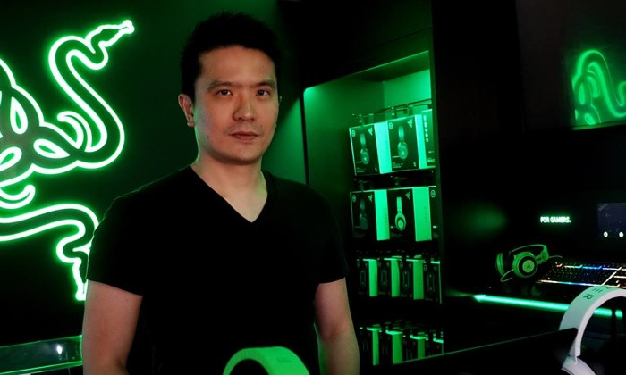
The Technopreneur
4. Technopreneurs

Slide 19
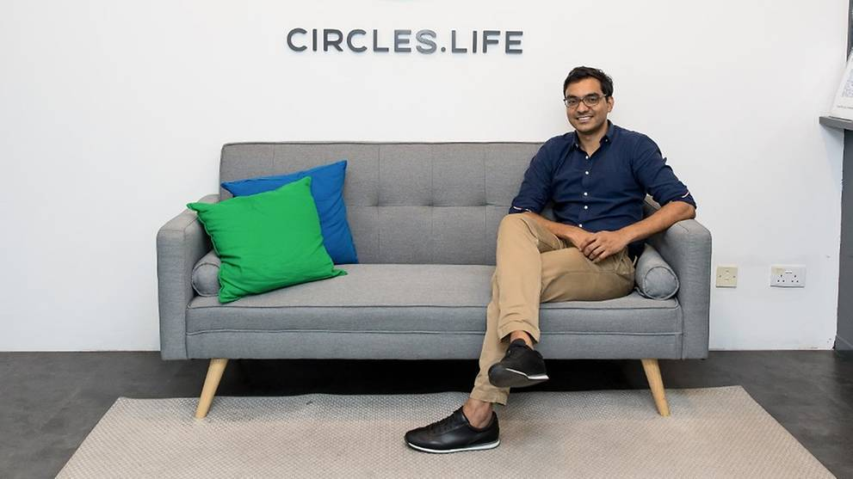
Telco innovators…
Rameez Ansar. Circles.Life
Co-founder.

Slide 20
Concluding Thoughts…
As the nature of entrepreneurship has changed over time in some ways reflecting the evolving social, political, and economic conditions in Singapore.
How important is philanthropy and being a ‘cultural entrepreneur’ in the present day?
What drives entrepreneurs? And conversely, what limits entrepreneurs?

Slide 21
For further reading:
A speech by Lee Kuan Yew on entrepreneurs being ‘born’ with innate skills.
https://www.smu.edu.sg/site/sites/default/files/microsites/hrh/pdf/SGP_20020205_MM-Lee-Speech.pdf
On Circles.Life:
https://www.forbes.com/sites/tarandipkaur/2018/07/19/how-circles-life-created-the-netflix-of-telco-in-singapore/#5ae7d80e584e

